Slide 1

Managing AVD with Intune, What to expect? Start 13:00
Stefan Dingemanse
Niels Kok

Slide 2
Questions
Who uses AVD?
Managed by Intune?

Slide 3
Goal

Slide 4

Niels
Kok
Consultant/Architect

Slide 5

Stefan
Dingemanse
Microsoft (Cloud) Consultant @ Brainpulse IT

Slide 6

Agenda
Down the rabbit hole
Configuration
Image Management
Profile solutions
Security & compliance
Management / Support
Recap
Notes:
STEFAN

Slide 7
Known limitations
Azure Virtual Desktop (classic) is not supported
External identities is not supported
Azure Files shares or Azure NetApp Files shares for hybrid users
Microsoft Entra Domain Services joined machine can’t be managed with Intune
Notes:
STEFAN

Slide 8
Test setup
Entra ID as IDP
Microsoft Intune for management
Storage account for profiles
Using Windows 11 (Multi-Session)
Didn’t test Server OS (Who’s using server OS with AVD?)
Notes:
STEFAN

Slide 9
Configuration
Notes:
STEFAN
Doel: Uitleggen wat er allemaal nodig is om uberhaupt een Entra ID Joined session host in de lucht te krijgen. Waar moet je op letten, welke configuraties moet je doorvoeren.

Slide 10
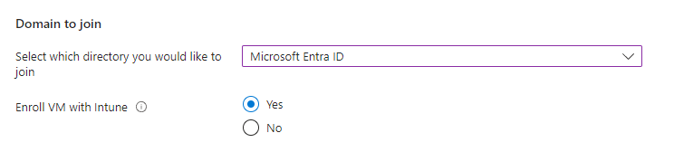
Microsoft Entra joined VM / Intune enrollment
Azure Portal integration
Can be automatically joined to Microsoft Entra ID
Can be automatically enrolled to Intune
Notes:
STEFAN
Lets start with the configuration of AVD

Slide 11
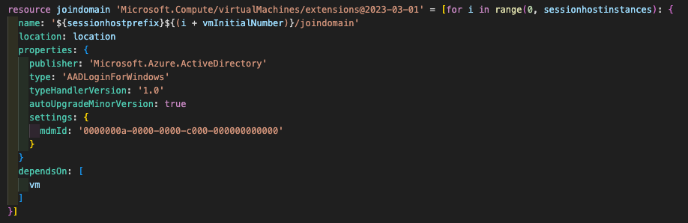
Microsoft Entra joined VM / Intune enrollment
Automation
Notes:
STEFAN
The AADLoginForWindows extension on an Azure VM allows you to use Azure Active Directory (Azure AD) to authenticate to a Windows virtual machine (VM) in Azure. This means that you can use your Azure AD credentials to sign in to the VM, instead of using a local administrator account. You can install the AADLoginForWindows extension on an existing Windows Server 2019 or Windows 10 1809 and later VM to enable it for Microsoft Azure AD authentication

Slide 12
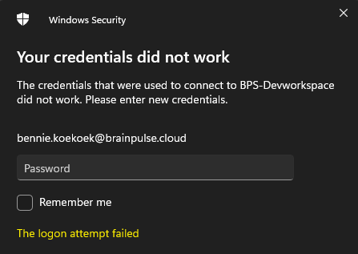
Role assignment
With great powers comes great responsibilities
Users: Virtual Machine User Login
Administrators: Virtual Machine Administrator Login
Resource group level!
Notes:
STEFAN
Be carefull, administrator privileges

Slide 13
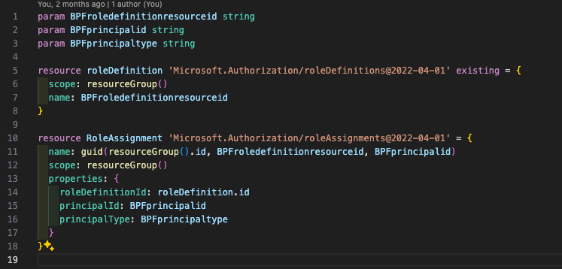
Role assignment
Automated way
Notes:
STEFAN

Slide 14
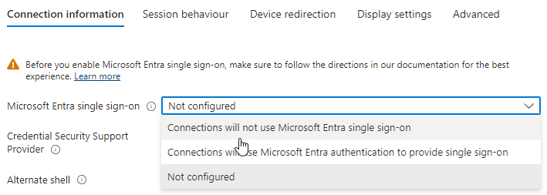
Custom RDP properties
Microsoft Entra single sign-on settings
targetisaadjoined:i:1
enablerdsaadauth:i:1
Access Entra joined host via web, android, macos or iOS client

Slide 15
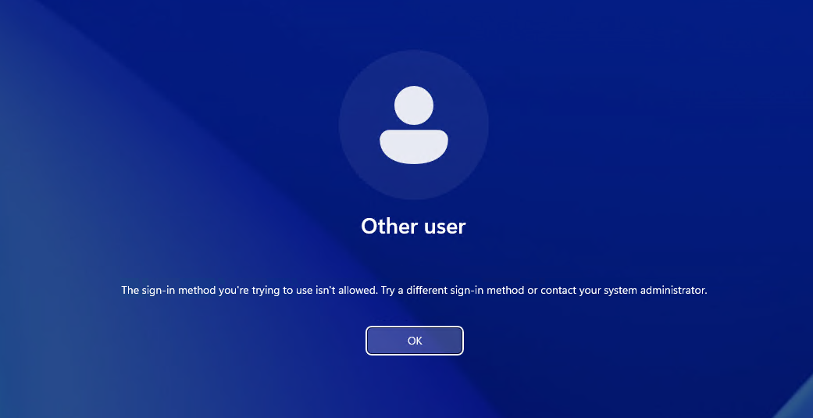

Slide 16
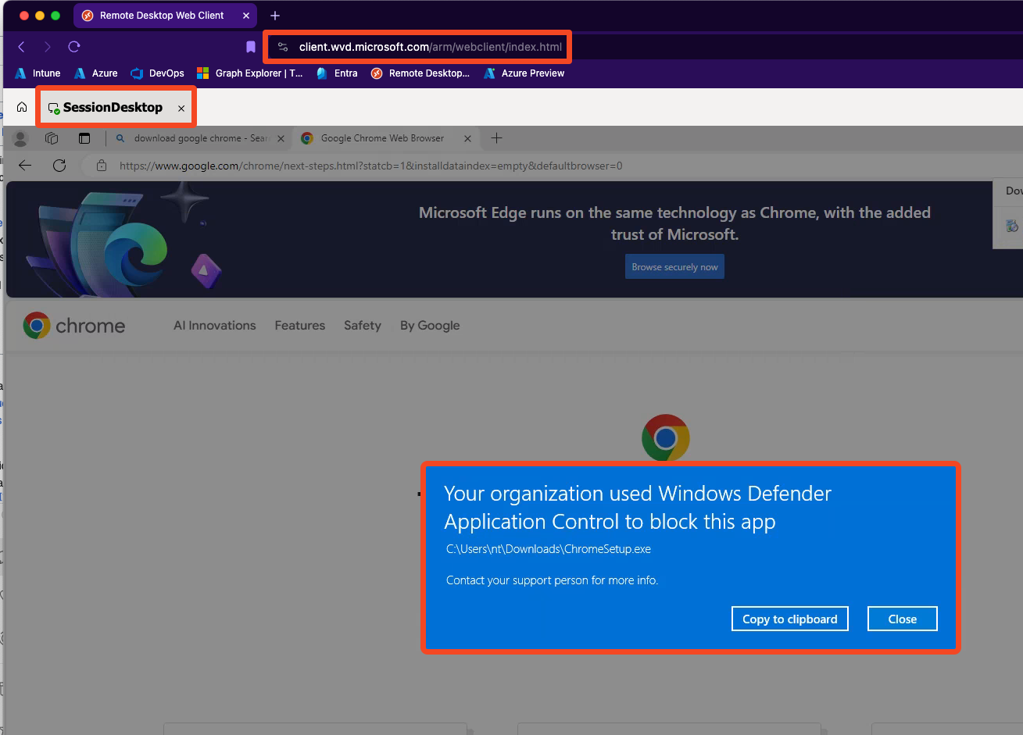
WDAC

Slide 17
Single-session VS multi-session
Single-session management is the same as current physical endpoints managed by Intune. (Windows 365)
Multi-Session: User based, and device-based configuration is supported, not all types of configurations are supported
Notes:
Verschil, niet alles supported. Daarom volgende slides om te laten zien.

Slide 18
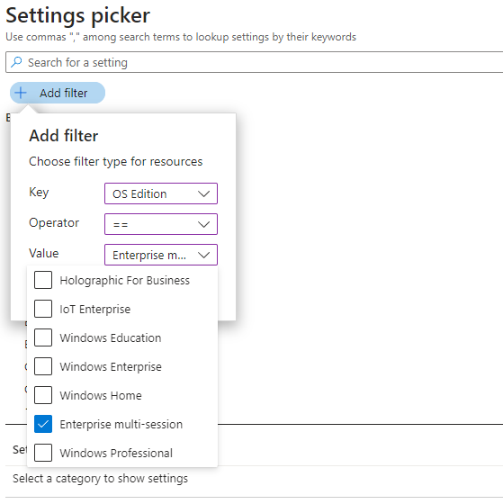
Settings filter
Choose your settings

Slide 19
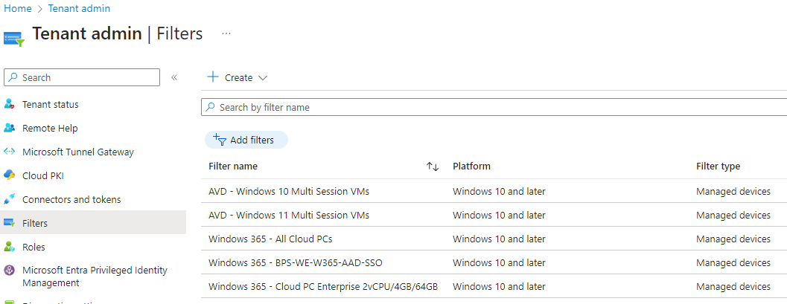
Filters
Organizing session hosts
Filters are faster
Specific targeting
Can be included and excluded
Notes:
Device model: Virtual Machine
Operating system: Windows
Operating system edition: EnterpriseMultisession
(device.operatingSystemSKU -eq "ServerRdsh")

Slide 20
Filters AVD examples
All Windows 10 Multi Session
(device.operatingSystemSKU -eq "ServerRdsh") and (device.osVersion -startsWith "10.0.1")
All Windows 11 Multi Session
(device.operatingSystemSKU -eq "ServerRdsh") and (device.osVersion -startsWith "10.0.2")

Slide 21
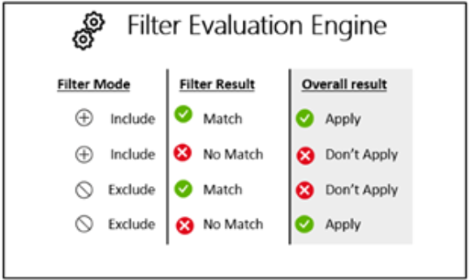
Filter evaluation
Organizing session hosts

Slide 22
Dynamic Groups or filtering?
It depends
Experience at customers…
Notes:
Device model: Virtual Machine
Operating system: Windows
Operating system edition: EnterpriseMultisession
Operating system SKU: Windows 10/11 Enterprise Multi-session (175)​
(device.operatingSystemSKU -eq "ServerRdsh")

Slide 23
Dynamic Groups
Example for Dynamic group:
(device.displayName -startsWith “AVD") and (device.deviceModel -eq "Virtual Machine")
(device.operatingSystemSKU -eq "ServerRdsh")
Notes:
Device model: Virtual Machine
Operating system: Windows
Operating system edition: EnterpriseMultisession
Operating system SKU: Windows 10/11 Enterprise Multi-session (175)​
(device.operatingSystemSKU -eq "ServerRdsh")

Slide 24
Custom OMA-URI
Not supported on multi-session

Slide 25
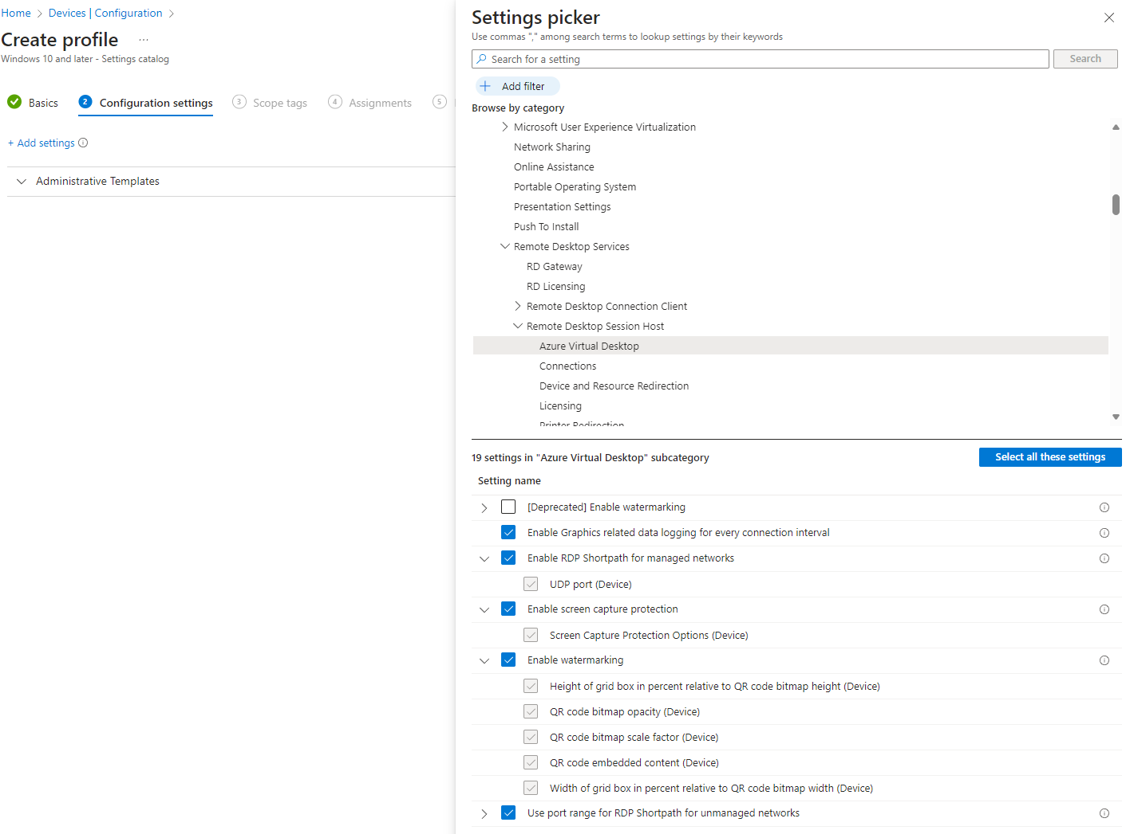
AVD specific settings
Put it in your golden image? Or apply dynamic

Slide 26
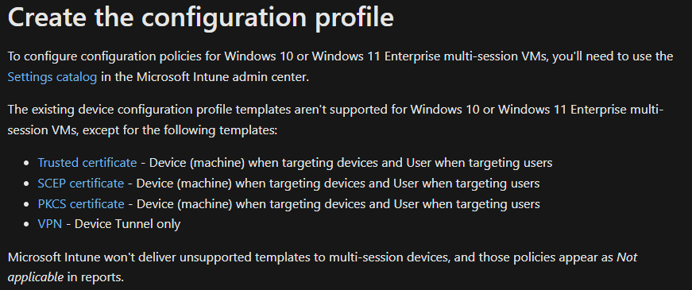
Configuration profiles templates
Configuration profiles are NOT supported except for:

Slide 27
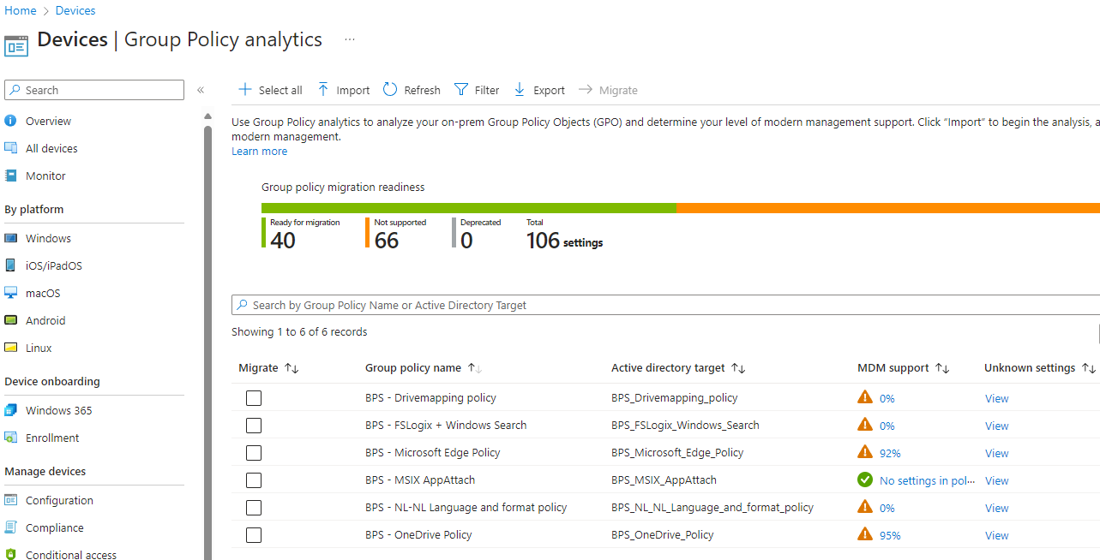
Group Policy Analytics
Use it for readiness
Don’t migrate
Keep It Simple

Slide 28
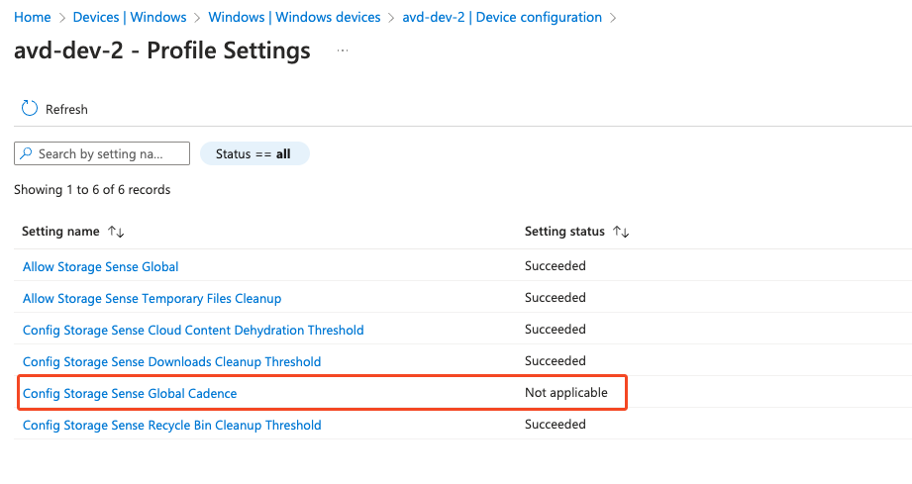
Multi-session / single-session
Storage sense
It does apply: but…

Slide 29
Applications (Multi-Session)
All installations within system/device context and targeted to device
All apps must be configured with Required or Uninstall
Notes:
STEFAN
Application deployment
All Windows 10 or Windows 11 apps can be deployed to Windows 10 or Windows 11 Enterprise multi-session with the following restrictions:
All apps must be configured to install in the system/device context and be targeted to devices. Web apps are always applied in the user context by default so they won't apply to multi-session VMs.
All apps must be configured with Required or Uninstall app assignment intent. The Available apps deployment intent isn't supported on multi-session VMs.
If a Win32 app configured to install in the system context has dependencies or supersedence relationship on any apps configured to install in the user context, the app won't be installed. To apply to a Windows 10 or Windows 11 Enterprise multi-session VM, create a separate instance of the system context app or make sure all app dependencies are configured to install in the system context.
Azure Virtual Desktop RemoteApp and MSIX app attach aren't currently supported in Microsoft Intune.

Slide 30
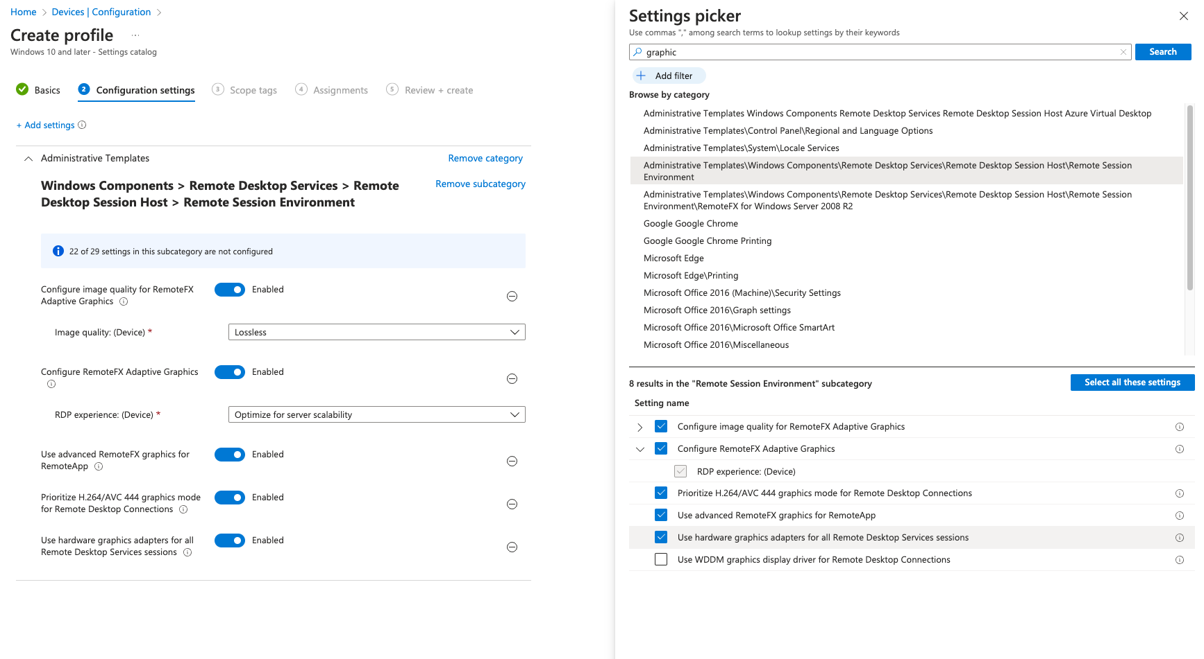
GPU enabled session hosts
How to configure relevant settings
Settings available in Settings Catalog
Use extension to install drivers

Slide 31
Break down
Always verify settings, success doesn’t always means applied and used
Windows 10 or Windows 11 Enterprise multi-session VMs are treated as a separate OS edition
Windows 10 Enterprise multi-session is a virtual edition of Windows 10 Enterprise, this operating system (OS) reports the ProductType as having a value of 3, the same value as Windows Server
To configure configuration policies for Windows 10 or Windows 11 Enterprise multi-session VMs, you'll need to use the Settings catalog (select Add filter with OS Edition Enterprise multi-session)
Windows 10 or Windows 11 Administrative Templates are supported for Windows 10 or Windows 11 Enterprise multi-session via the Settings catalog with some limitations
The existing device configuration profile templates aren't supported for Windows 10 or Windows 11 Enterprise multi-session VMs, except for the following templates: Certs, VPN.
Notes:
STEFAN

Slide 32
Image Management
Notes:
STEFAN

Slide 33
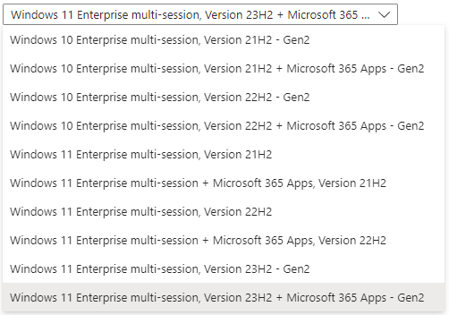
Gallery Images
Single Session
Multi Session
Notes:
NIELS

Slide 34
Intune Based
Master Image enrollment Entra ID / Intune
Applications required, no other policies
Dsregcmd /leave
Remove Intune extensions and relevant keys
Notes:
Niels plaatje toevoegen

Slide 35





Microsoft Intune
Intune Enrollment
Applications
Pushed
Disconnect Intune
Remove
Resources

Slide 36
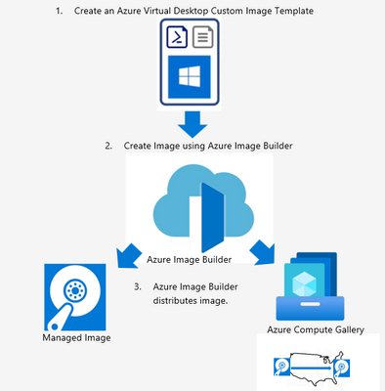
Custom image templates
Built on Azure Image Builder
Output:
Managed Image
Azure Compute Gallery

Slide 37
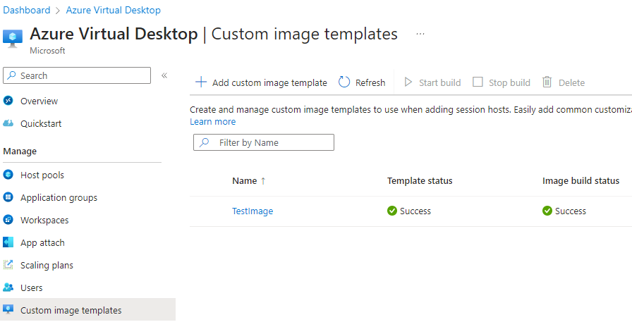
Custom Image Templates integration

Slide 38
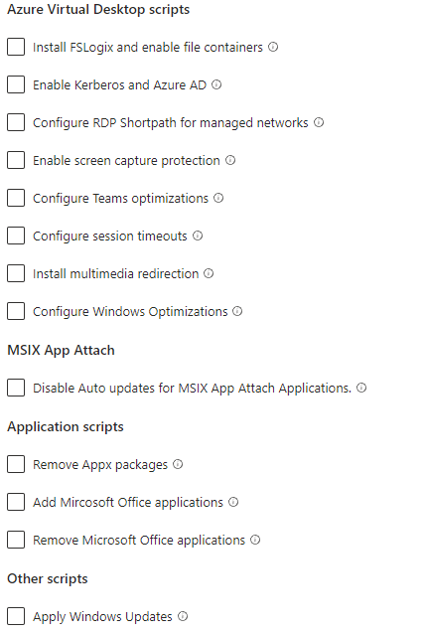
Built-in scripts
Ready to use
Built-in scripts
Own custom scripts

Slide 39
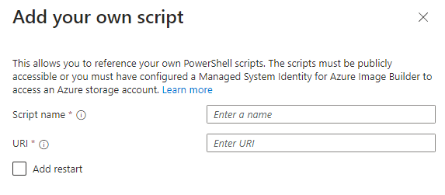
Custom scripts
Create your own
Must be publicly available
Or via Managed System Identity to Storage Account

Slide 40

Packer via DevOps
Notes:
Niels plaatje toevoegen

Slide 41
Notes
Golden Image cannot be Entra ID joined
Golden Image cannot be Intune enrolled
Defender for Endpoint not onboarded
Notes:
Onboarding and servicing non-persistent VDI machines with Microsoft Defender ATP - Microsoft Community Hub

Slide 42
App Attach (Preview)
Notes:
STEFAN

Slide 43
MSIX app attach vs App attach
Where: Any application can be applied to any session host
Who: Applications are now only shown to the people you choose
Update: You can update an application without interrupting
Format: MSIX, AppX or bundle format
Modify: All scenarios support
Identity: Support for Entra ID join!

Slide 44
Support for Microsoft Entra ID
Azure Files with Microsoft Entra ID joined session hosts
Reader and Data Access Azure role to:
Azure Virtual Desktop
Azure Virtual Desktop ARM Provider
Notes:
STEFAN

Slide 45
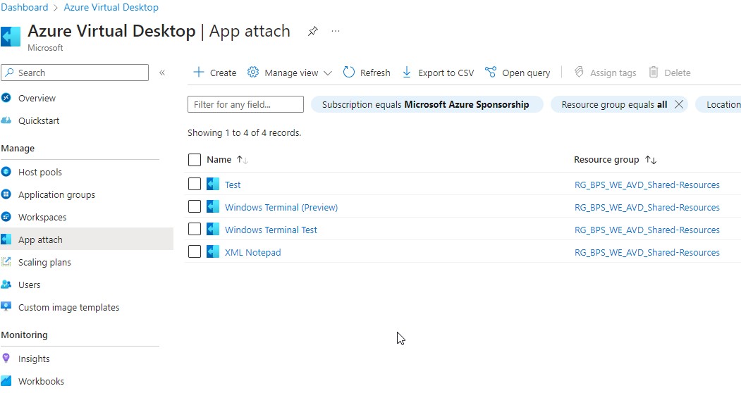
App Attach (Preview)

Slide 46
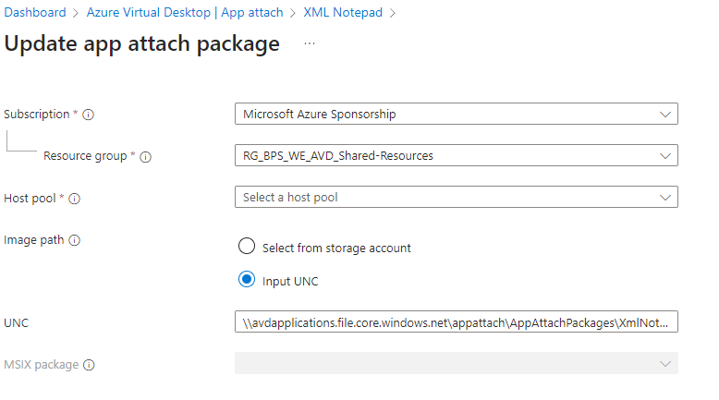
Updating App Attach package
Multiple versions at the same time
Update package without user interuption

Slide 47
Profile solutions
Notes:
NIELS

Slide 48
Profile Management with FSLogix
FSLogix deployment types
Configuration
Applied immediately after deploying or?

Slide 49



FSLogix Cloud Only Users
Microsoft 365
Services
Intune
Entra ID
Managed By Intune
Authentication
Cloud Only Users
Access via Storage Account Key
Storage Account
FS Logix FileShare
AVD Devices
Notes:
NIELS

Slide 50

Microsoft 365
Services
FSLogix Cloud Hybrid Users Users
On-Prem DC
Intune
Entra ID
Sync
Active Directory
Managed By Intune
Microsoft Entra
Kerberos
Storage Account
FS Logix FileShare
AVD Devices
Notes:
NIELS

Slide 51
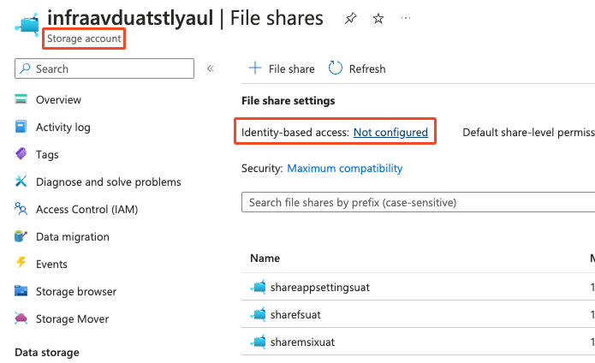
Deployment overview

Slide 52
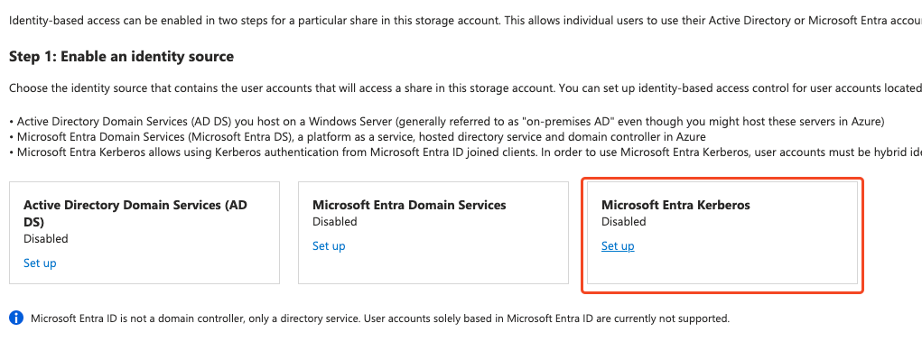
Notes:
NIELS

Slide 53
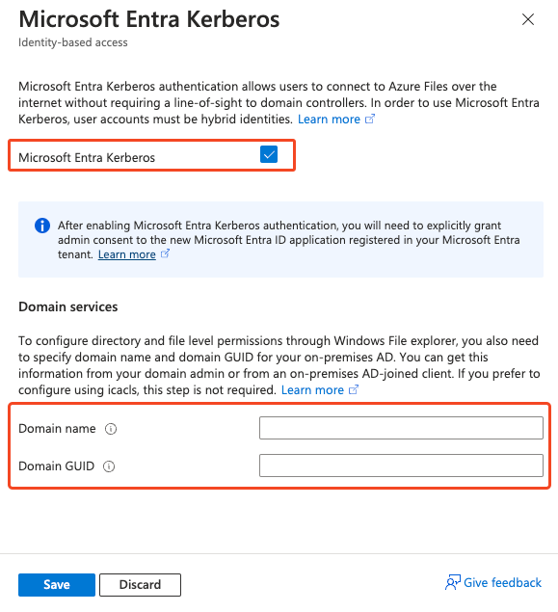
Notes:
NIELS

Slide 54
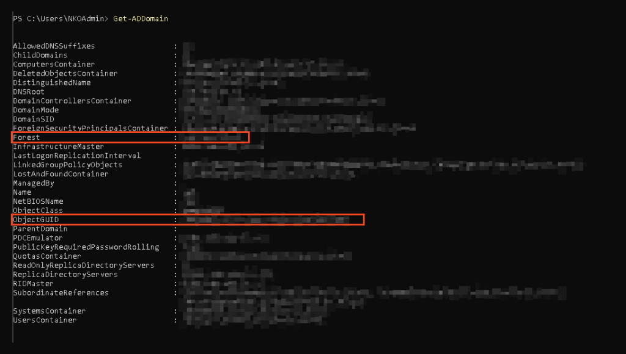
Notes:
NIELS

Slide 55
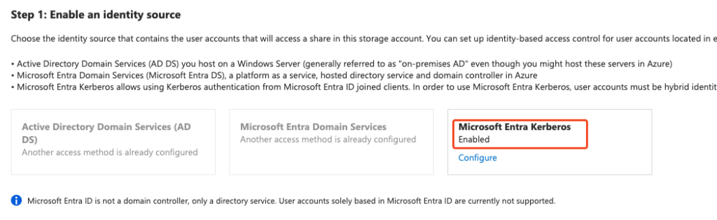
Notes:
NIELS

Slide 56
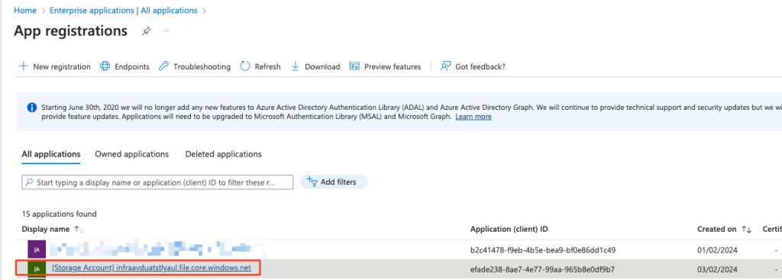
Notes:
NIELS

Slide 57
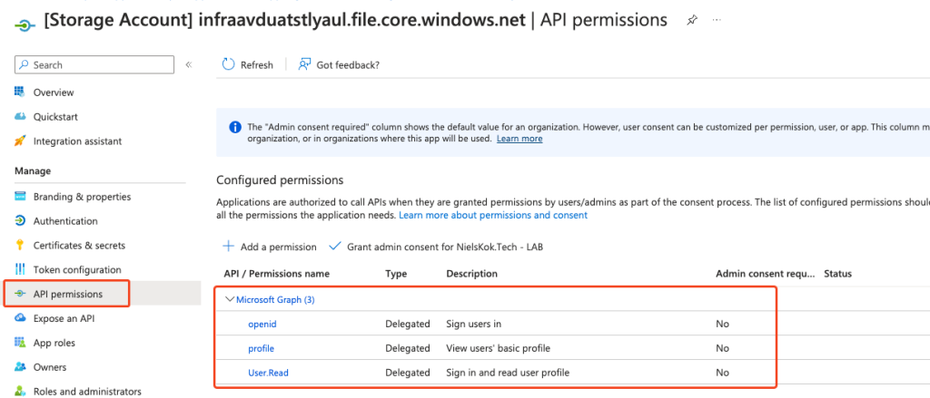
Notes:
NIELS

Slide 58
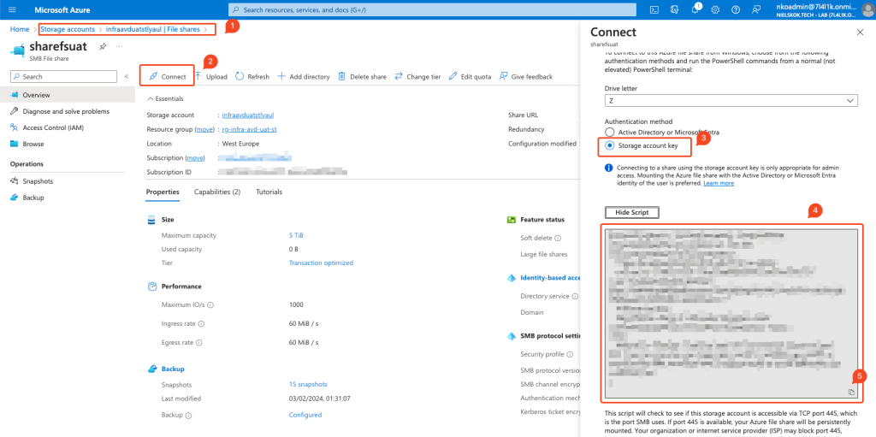
Notes:
NIELS

Slide 59
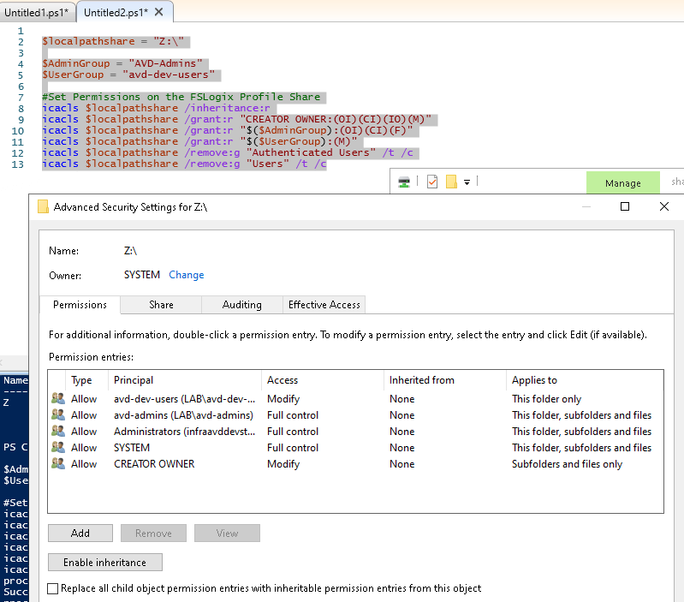
Notes:
NIELS

Slide 60
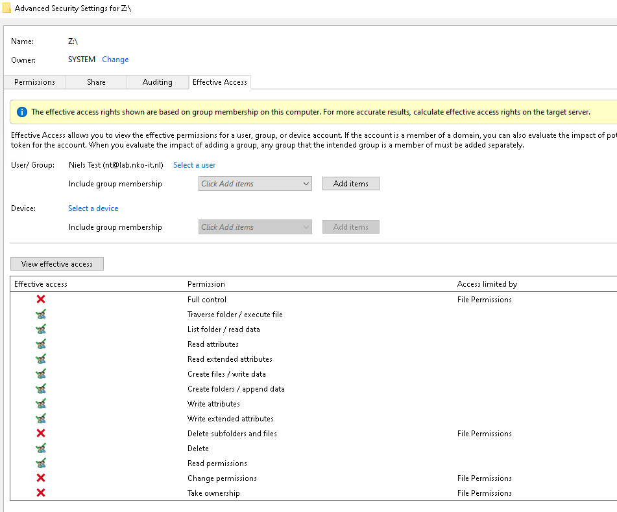
Notes:
NIELS

Slide 61
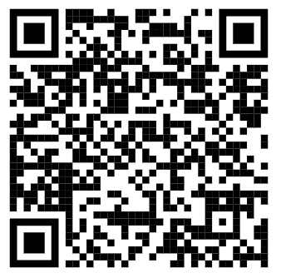
Blog article
Notes:
NIELS

Slide 62
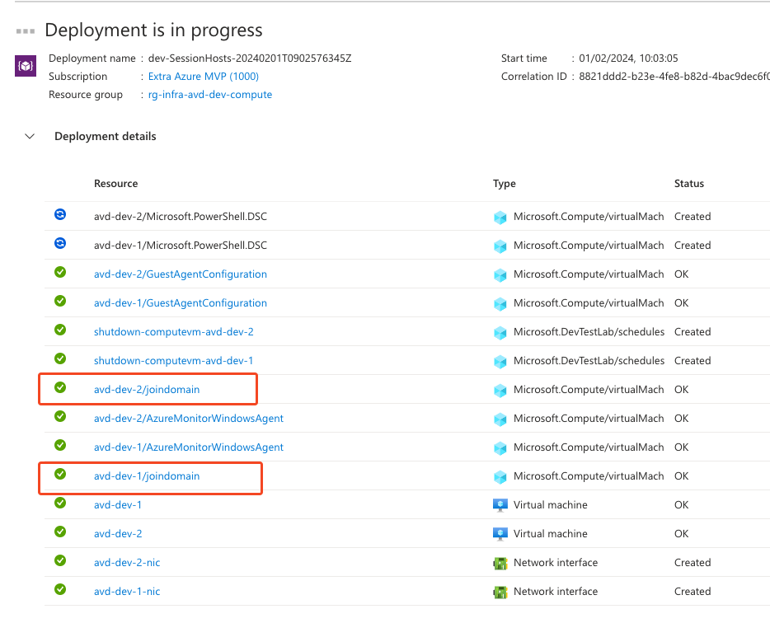
VM Deployment
Notes:
NIELS

Slide 63
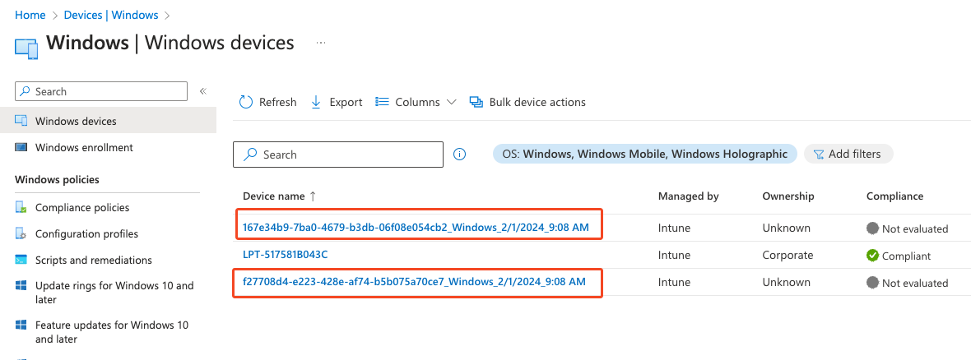
Weird names:

Slide 64
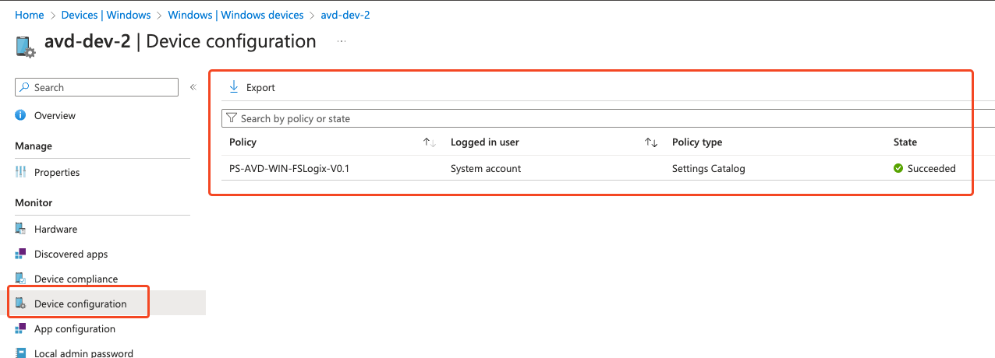
Configurations:

Slide 65
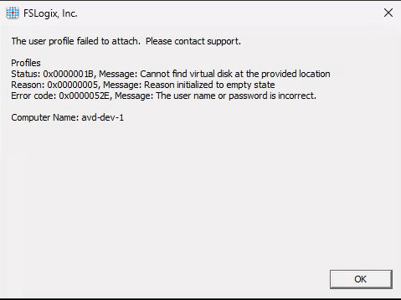

Slide 66


Slide 67
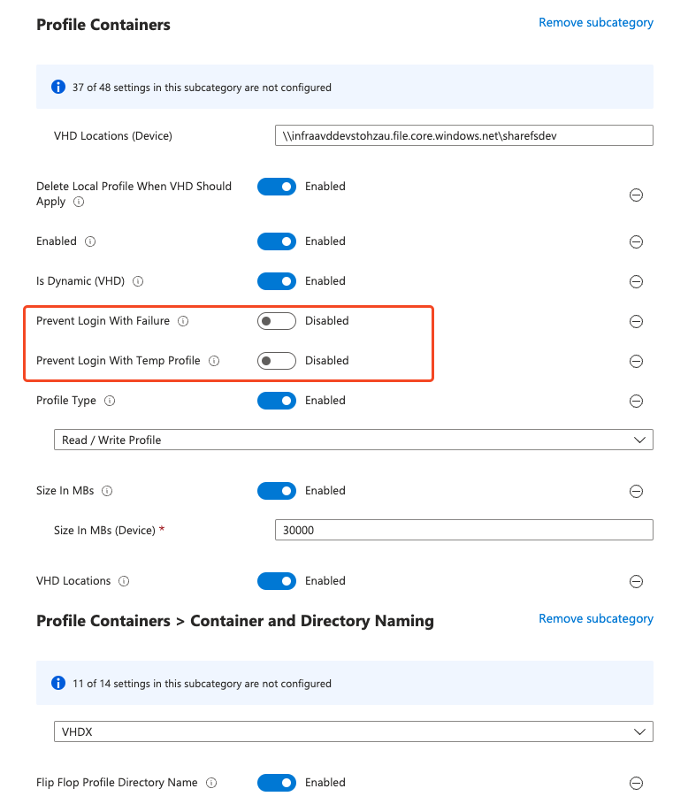
Synced within minutes
Settings Catalog

Slide 68
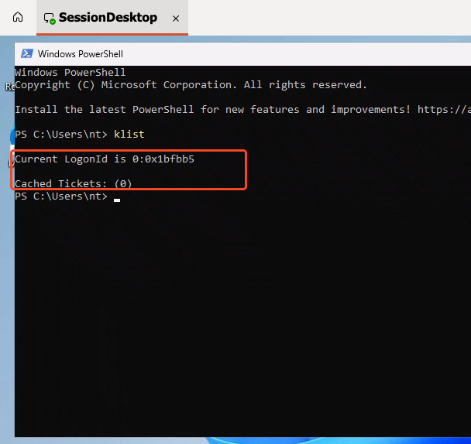

Slide 69
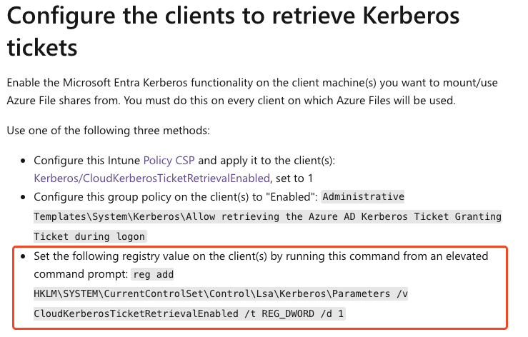

Slide 70
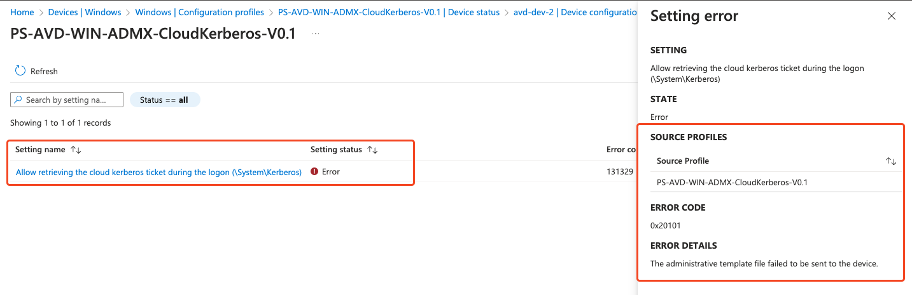

Slide 71

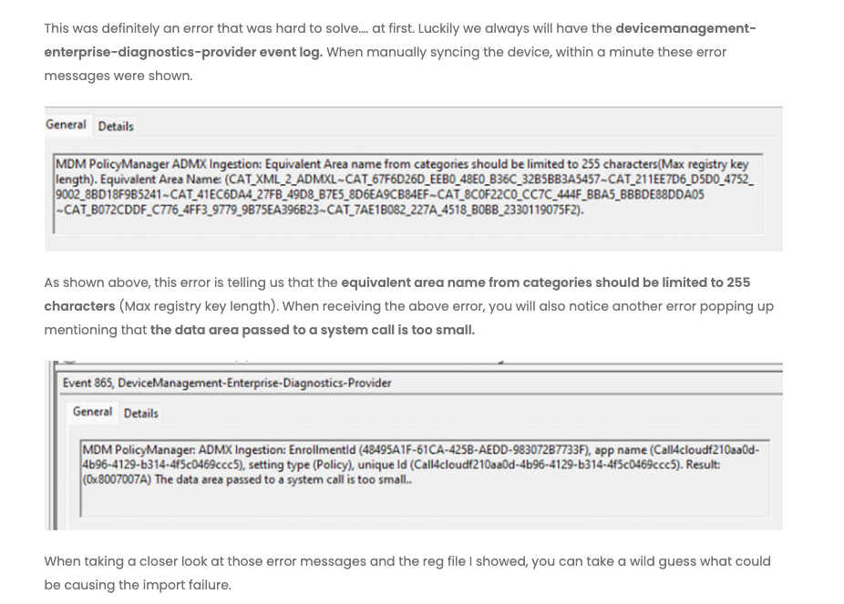
Rudy’s blog

Slide 72
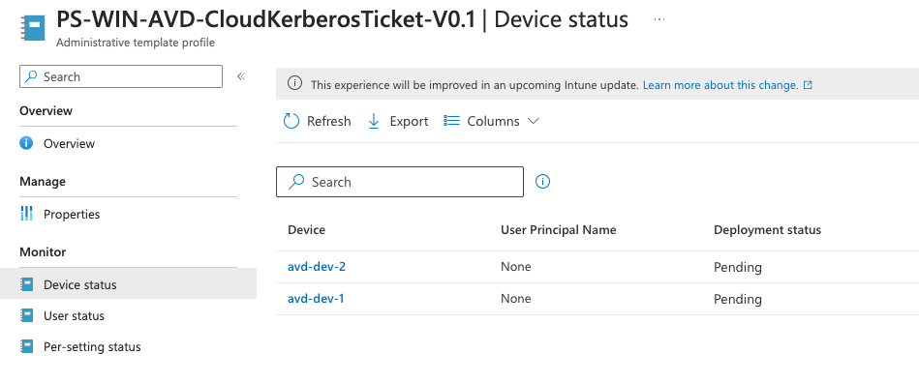

Slide 73
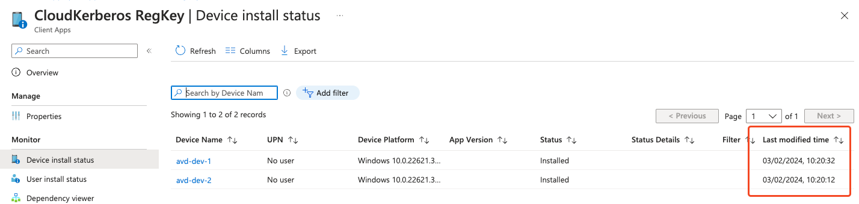
Win32App, works

Slide 74
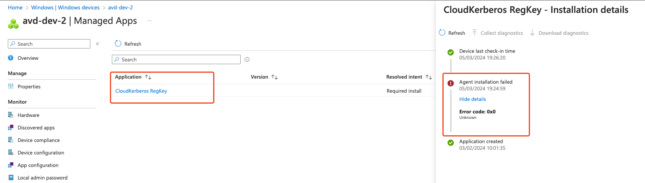
Win32App, but then it didn’t

Slide 75
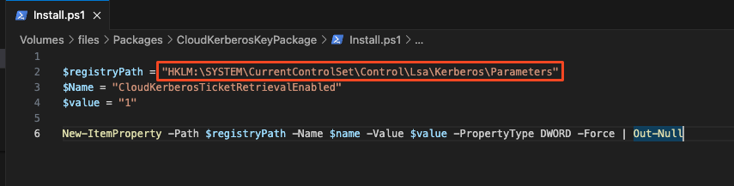
Image Pipeline, didn’t work

Slide 76
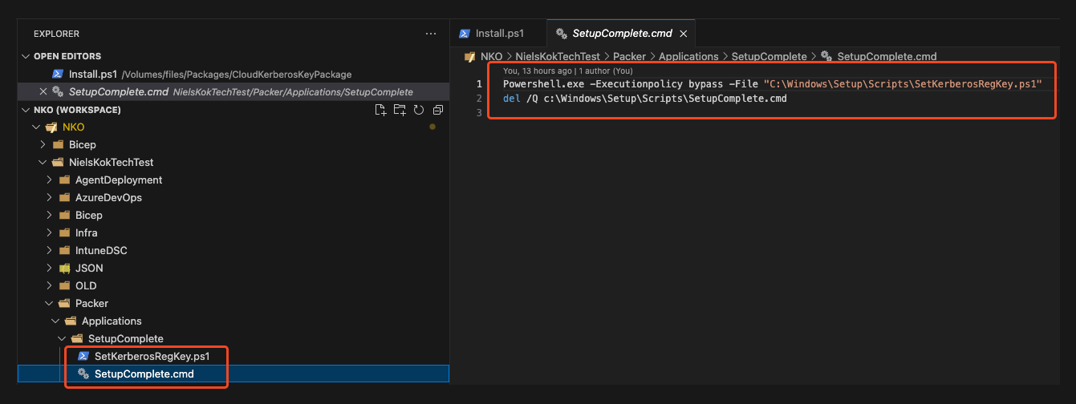
Image Pipeline, works with a fix

Slide 77
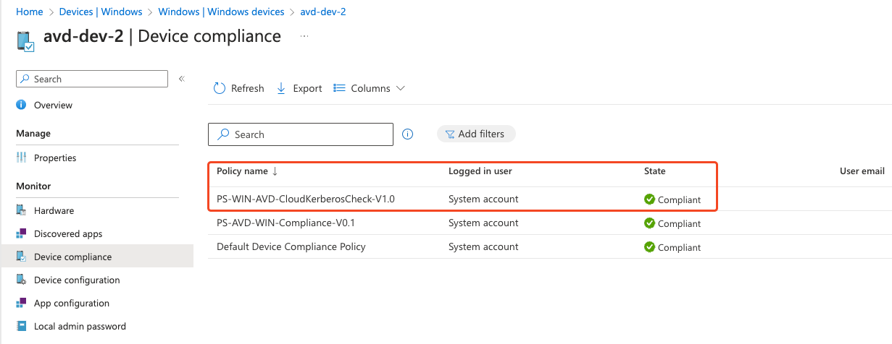
Custom Compliance for Regkey

Slide 78
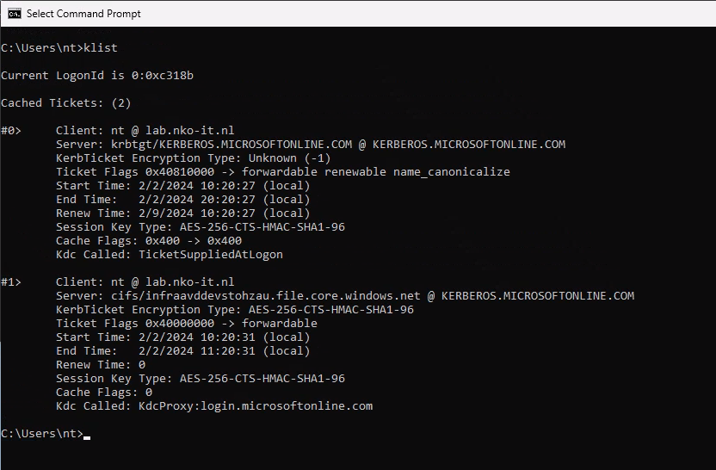

Slide 79
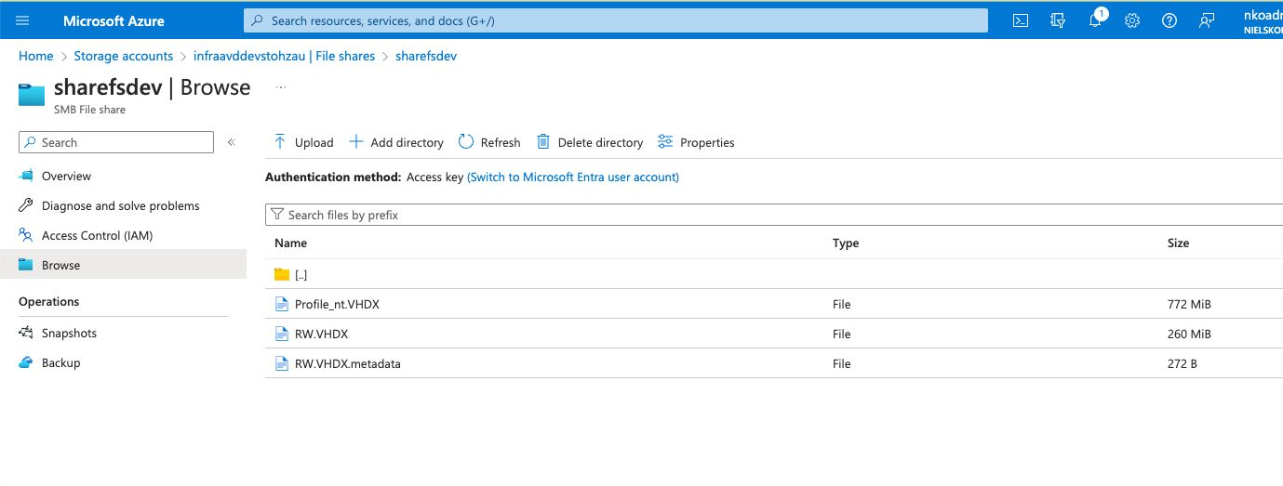

Slide 80


Slide 81
So, join storage account to domain or not?

Slide 82
Security

Slide 83

Local Administrator Password Solution
LAPS
SUPPORTED
Make sure you use the correct administrator account name

Slide 84
Security Baselines
According to Microsoft not supported
BUT THERE IS SOME NEWS
New security baselines for 23H2 using the Settings Catalog
Edge baseline is applied
Windows 10 security baseline applied with Not applicable settings

Slide 85

Defender for Endpoint onboarding AVD
Single entry (Recommended)
Multiple entries
Golden Image is NOT onboarded to Defender
Add onboarding script to golden image

Slide 86
Defender for Endpoint – Device tags
Registry key: HKEY_LOCAL_MACHINE\SOFTWARE\Policies\Microsoft\Windows Advanced Threat Protection\DeviceTagging\
Registry key value (REG_SZ): Group
Registry key data: Name of the tag you want to set
Custom OMA URI is not supported on Multi-Session

Slide 87

Windows Updates
Update rings aren’t supported on Multi-Session OS
Autopatch is not supported
Windows Update for Business
Golden Image, not needed?
Notes:
Waarom zou je multi-session OS updaten als je met golden image werkt.

Slide 88

Endpoint security
IF platform is Windows 10, Windows 11, and Windows server the settings are supported.
Otherwise, the profile is not supported on multi-session.

Slide 89

Multi-session – Local Group Membership

Slide 90


Slide 91
Compliance

Slide 92
Compliance Entra Joined
Entra/Intune Join
AVD Devices
Microsoft Intune

Slide 93

Grace Period

Slide 94


Compliance Active Directory Joined
Microsoft Intune
Entra/Intune Join
Synced via AD Connect
Replaces Existing Device
Active Directory Join
AVD Devices
Active Directory – AD Connect
Notes:
Heeft nog aanvulling nodig ten opzichte van het certificaat voor Hybrid Join. Als het certificaat er gaat het pas lopen.

Slide 95

Hybrid Join Shenanigans

Slide 96

Compliance Shenanigans

Slide 97
Compliance types
Device based compliance
User based compliance

Slide 98

Deployment Entra ID Joined

Slide 99


Slide 100


Slide 101


Slide 102


Slide 103


Slide 104


Slide 105


Slide 107


Slide 108


Slide 109

PowerShell Task in Azure DevOps

Slide 112

With Disk Encryption?

Slide 113

First time it failed

Slide 114


What did Intune Show?

Slide 115
Windows 11 RSA key 4096

Slide 116

Second time the charm?

Slide 117


Compliance?
19:57

Slide 118



Slide 119

Time out on Pipeline

Slide 120


Slide 121

https://call4cloud.nl/2023/04/are-you-there-intune-its-me-hac/

Slide 122


Slide 123


Custom compliance for bitlocker?

Slide 124



Custom compliance for bitlocker?

Slide 125

Compliant, nope, this also took a couple of hours
It only check custom compliance once every 8 hours… So yeah…

Slide 126


Slide 127


Slide 128
Bitlocker
Azure Disk Encryption
4096 Key in keyvault
Device Health Attestation Issues
Compliance
Custom Compliance

Slide 129

Bitlocker

Slide 130
W365 Encryption?

Slide 131

Timelines

Slide 132
Management

Slide 133
Remote actions
Control AVD via Intune
The following actions are not supported
Autopilot reset
BitLocker key rotation
Fresh Start
Remote lock
Reset password
Wipe
Notes:
Stefan

Slide 134
Updates
Keeping your environment up 2 date
What are the options / what is supported
Golden Image
Update Rings (Not supported on Multi Session)
Notes:
Using Azure Virtual Desktop multi-session with Microsoft Intune | Microsoft Learn
NIels

Slide 135

Update ring on multi session

Slide 136
Housekeeping
Keeping your environment in a healthy state
Cleanup orphaned entries (Entra ID/Intune)
Notes:
Stefan

Slide 137
Recap

Slide 138
Configurations
What’s different from Domain Joined traditional managed
Initial setup is quite easy and straight forward
Single-session: will completely work, no differences with physical endpoints
Multi-Session: can be configured with Intune with some exceptions
Notes:
STEFAN

Slide 139
Multi-session
What’s supported
Configuration | Single-session | Multi-Session | Note
Settings Catalog | ✅ | ✅ | (WDAC)
Configuration profiles | ✅ | ❌ | *
Application Deployment | ✅ | ✅
Script deployment | ✅ | ✅
Windows Update for Business | ✅ | ✅ | *
Windows Update Deployment rings | ✅ | ❌
Remote Actions | ✅ | ✅
Security Baselines | ✅ | ✅ | *
Autopilot / ESP | ✅ | ❌
LAPS | ✅ | ✅
Compliance configuration | ✅ | ✅
Custom OMA URI | ✅ | ❌ | (Applocker)
Notes:
STEFAN

Slide 140
FSLogix
Profile Solution
Still need hybrid users for supported configuration, fully cloud not an option
Cloud users
Hybrid users
Notes:
NIELS

Slide 141

Documentation
Is this the truth?
The information on Microsoft Entra joined session hosts in Azure Virtual Desktop needs some love and attention from Microsoft.
Notes:
STEFAN

Slide 142
Always validate
Test, test, test
Validate if settings are being applied
Verify if it is supported
Featureset Multi-Session Image
Notes:
NIELS

Slide 143



Questions?
Niels LinkedIn:
Stefan LinkedIn:

